Slide 1

EXCEL MODULE 2 – FORMULAS RECAP
Enhancing Your Data Analysis Skills Pathway
2023

Slide 2
Agenda
What can you do with Excel formulas?
Elements of an Excel formula
Creating formulas in Excel
Mathematical operators
Exercise

Slide 3

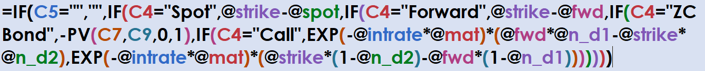
What can you do with Excel Formulas?
Mathematical expressions that calculate the value of cell contents
Can perform multiple mathematical operations
Results of these operations will be shown in the cell that contains the formula
Formulas can be simple or complex

Slide 4
Elements of an Excel Formula
1
Formulas are always preceded by an equals sign (=).
Formulas can contain:
Numbers → =25+15
Cell references → =A1+D7
Functions → =SUM(B2:B9)
2
Cell references are not case-sensitive.
=A1+23, = d2-c2, and =B10+b11/C6 are all valid formulas.
3

Slide 5
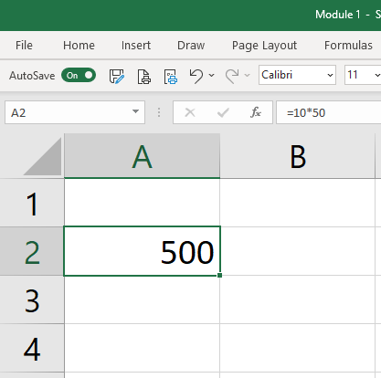
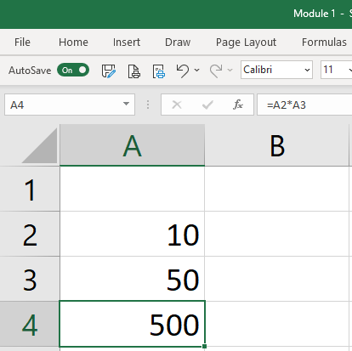
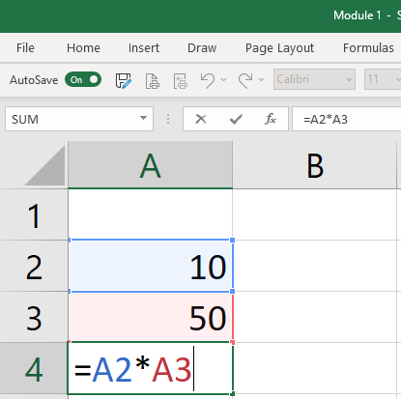
Creating Formulas in excel
You can use value from other cells as input into formulas.
You can enter a formula by typing directly into a cell or into the formula bar.
Always start a formula with ‘=‘
When in a cell, press F2 to see and edit the formula.
Press ENTER to exit the formula and save the changes.
Press ESC to exit the formula without saving changes.
Notes:
You can enter a formula by typing directly into a cell or into the formula bar.

Slide 6
Mathematical Operators
NAME | SYMBOL | EXAMPLE
Add | + | 10+2 = 12
Subtract | - | 10-2 = 8
Multiply | * | 10*2 = 20
Divide | / | 10/2 = 5
Exponent | ^ | 10^2 = 100
Equivalence | = | 10 = 10
Greater (or Equal) Than | > | 10>2 (10>=2)
Less (or Equal) Than | < | 2<10 (2<=10)

Slide 7
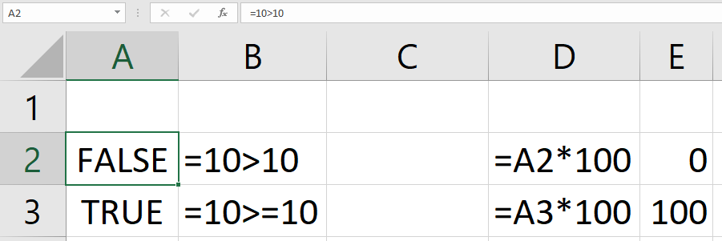
Booleans – true or false
The output of an Excel formula can be a Boolean value, meaning it can only contain two values: TRUE or FALSE.
In Excel TRUE = 1 and FALSE = 0.
Multiplying by “FALSE” = Multiplying by 0
Multiplying by “TRUE” = Multiplying by 1

Slide 8
Useful excel functions
FUNCTION | DESCRIPTION
=SUM() | Calculates the sum of a range of cells. The shortcut for this function is ALT + ‘=‘.
=SUMPRODUCT() | Takes the sum of the product of two ranges of cells
=SQRT() | Takes the square root of a number
=AVERAGE() | Calculates the average of a range of cells.
=MAX() and =MIN() | Calculates the maximum / minimum value of a range of cells.
=PV() and =FV() | Calculates present / future value of a (series of) cashflows.

Slide 9
Modelling Good practices
Every variable in your model should only have ONE cell.
This will make updating your model significantly easier and more error proof.
Never enter a variable twice!
Never put hard coded numbers into a formula!
This will making changes to your model and auditing it much more flexible and easier (also for other people).

